Slide 1
AI ON-THE-SPOT (2)
ROI & Elasticity Calculations

Slide 2
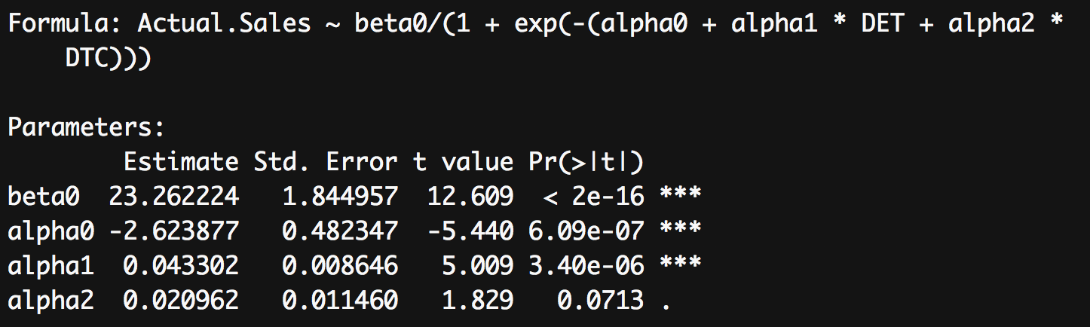
Promotional ROI for SSRI Therapeutic Class
SDI.csv provides yearly aggregate sales ($Billions), Detailing (DET) and Direct-to-Consumer Advertising (DTC) spend ($Millions) for the prescription drugs in the SSRI therapeutic class from 1996 to 2007.
The R commands and output for a logistic regression model predicting sales as a function of promotional efforts is provided below.

Slide 3
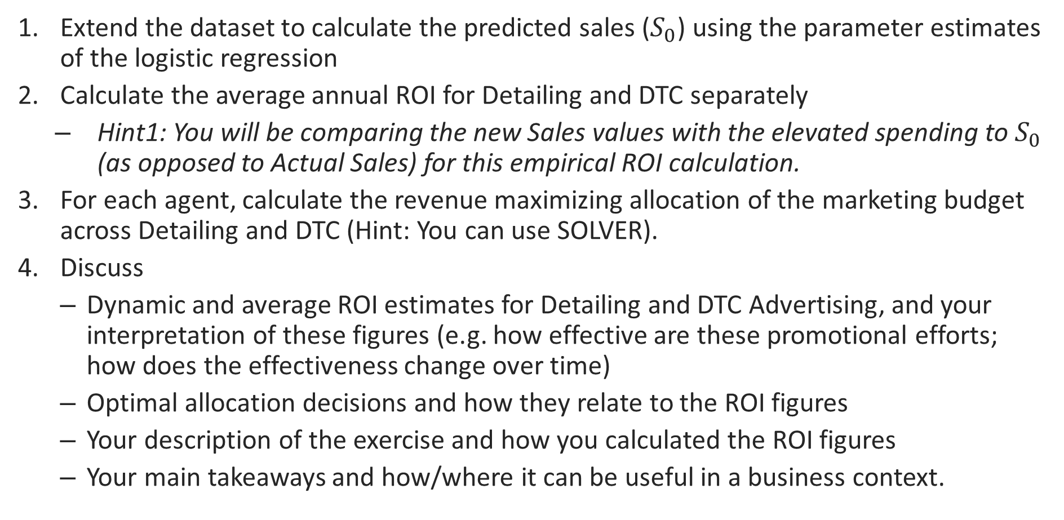
What You Need to Do:
Extend the dataset to calculate the predicted sales ($S_{0}$) using the parameter estimates of the logistic regression
Calculate the average annual ROI for Detailing and DTC separately
Hint1: You will be comparing the new Sales values with the elevated spending to $S_{0}$ (as opposed to Actual Sales) for this empirical ROI calculation.
For each agent, calculate the revenue maximizing allocation of the marketing budget across Detailing and DTC (Hint: You can use SOLVER).
Discuss
Dynamic and average ROI estimates for Detailing and DTC Advertising, and your interpretation of these figures (e.g. how effective are these promotional efforts; how does the effectiveness change over time)
Optimal allocation decisions and how they relate to the ROI figures
Your description of the exercise and how you calculated the ROI figures
Your main takeaways and how/where it can be useful in a business context.

